Slide 1
Agile Development

Slide 2
The Manifesto for
Agile Software Development
“We are uncovering better ways of developing software by doing it and helping others do it. Through this work we have come to value:
  Individuals and interactions over processes and tools
  Working software over comprehensive documentation
  Customer collaboration over contract negotiation
  Responding to change over following a plan
That is, while there is value in the items on the right, we value the items on the left more.”
Kent Beck et al, 2001

Slide 3
What is “Agility”?
Effective (rapid and adaptive) response to change (team members, new technology, requirements)
Effective communication among all team members, technological and business people, software engineers and managers
Drawing the customer into the team. Eliminate “us and them” attitude.
Planning in an uncertain world has its limits and plan must be flexible.
Organizing a team so that it is in control of the work
Eliminate all but the most essential work products and keep them lean.
Emphasize an incremental delivery strategy that gets working software to the customer as rapidly as feasible.

Slide 4
What is “Agility”?
Yielding …
Rapid, incremental delivery of software
The development guidelines stress delivery over analysis and design (although these are not discouraged),
Active and continuous communication between developers and customers.

Slide 5
Why and What - “Agility”?
Why?
  The modern business environment is fast-paced and ever-changing.
  Agility represents a reasonable alternative to conventional software engineering for certain classes of software projects.
  It has been demonstrated to deliver successful systems quickly.
What?
  May be termed as “software engineering lite”
  The basic activities- communication, planning, modeling, construction and deployment remain.
  But they morph into a minimal task set that push the team toward construction and delivery sooner.
The only really important work product is an operational “software increment” that is delivered.

Slide 6
Agility and the Cost of Change
Conventional wisdom is
  cost of change increases nonlinearly as a project progresses.
  It is relatively easy to accommodate a change when a team is gathering requirements early in a project.
  If there are any changes, the costs of doing this work are minimal.
But if the middle of validation testing, a stakeholder is requesting a major functional change. Then the change requires a modification to the architectural design, construction of new components, changes to other existing components, new testing and so on. Costs escalate quickly.
A well-designed agile process may “flatten” the cost of change curve by coupling incremental delivery with agile practices such as continuous unit testing and pair programming. Thus team can accommodate changes late in the software project without dramatic cost and time impact.

Slide 7

Agility and the Cost of Change

Slide 8
An Agile Process
Is driven by customer descriptions of what is required (scenarios).
Some assumptions:
  Recognize that plans are short-lived
  some requirements will persist, some will change. (Customer priorities will change)
  Develops software iteratively with a heavy emphasis on construction activities
  design and construction are interleaved
  Analysis, design, construction and testing are not predictable.
Adapt as changes occur due to unpredictability
Delivers multiple ‘software increments’, deliver an operational prototype or portion of a software to collect customer feedback for adaption.

Slide 9
Agility Principles - I
(As defined by Agile Alliance)
1. Our highest priority is to satisfy the customer through early and continuous delivery of valuable software.
2. Welcome changing requirements, even late in development. Agile processes harness change for the customer's competitive advantage.
3. Deliver working software frequently, from a couple of weeks to a couple of months, with a preference to the shorter timescale.
4. Business people and developers must work together daily throughout the project.
5. Build projects around motivated individuals. Give them the environment and support they need, and trust them to get the job done.
6. The most efficient and effective method of conveying information to and within a development team is face–to–face conversation.

Slide 10
Agility Principles - II
7. Working software is the primary measure of progress.
8. Agile processes promote sustainable development. The sponsors, developers, and users should be able to maintain a constant pace indefinitely.
9. Continuous attention to technical excellence and good design enhances agility.
10. Simplicity – the art of maximizing the amount of work not done – is essential.
11. The best architectures, requirements, and designs emerge from self–organizing teams.
12. At regular intervals, the team reflects on how to become more effective, then tunes and adjusts its behavior accordingly.
10 → means that a team can spend an amazing amount of time building a complex system that will handle all possible eventualities - or it can do only what is needed right now, get it right, and get it out the door.

Slide 11
Human Factors
The process moulds to the needs of the people and team, not the other way around
key traits must exist among the people on an agile team and the team itself:
  Competence. ( talent, skills, knowledge)
  Common focus. ( deliver a working software increment )
  Collaboration. ( peers and stakeholders)
  Decision-making ability. ( freedom to control its own destiny)
  Fuzzy problem-solving ability.
  Mutual trust and respect.
  Self-organization. (for the work, the process, the work schedule)

Slide 12
Extreme Programming (XP)
The most widely used agile process, originally proposed by Kent Beck in 2004. It uses an object-oriented approach.
XP Planning
  Begins with the listening, leads to creation of “user stories” that describes required output, features, and functionality. Customer assigns a value(i.e., a priority) to each story.
  Agile team assesses each story and assigns a cost (development weeks. If more than 3 weeks, customer asked to split into smaller stories)
  Working together, stories are grouped for a deliverable increment next release.
  A commitment (stories to be included, delivery date and other project matters) is made. Three ways: 1. Either all stories will be implemented in a few weeks, 2. high priority stories first, or 3. the riskiest stories will be implemented first.
  After the first increment ,“project velocity” (number of stories implemented during the first release) is used to help define subsequent delivery dates for other increments. Customers can add stories, delete existing stories, change values of an existing story, split stories as development work proceeds.

Slide 13
Extreme Programming (XP)
XP Design (occurs both before and after coding as refactoring is encouraged)
  Follows the KIS principle (keep it simple) Nothing more nothing less than the story.
  Encourage the use of CRC (class-responsibility-collaborator) cards in an object-oriented context. The only design work product of XP. They identify and organize the classes that are relevant to the current software increment.
  Encourages “refactoring”—an iterative refinement of the internal program design. Does not alter the external behavior yet improve the internal structure. Minimize chances of bugs. More efficient, easy to read.
XP Coding
  Recommends the construction of a unit test for a story before coding commences. So implementer can focus on what must be implemented to pass the test.
  Encourages “pair programming”. Two people work together at one workstation. Real time problem solving, real time review for quality assurance. Take slightly different roles.
XP Testing
  All unit tests are executed daily and ideally should be automated. Regression tests are conducted to test current and previous components.
  “Acceptance tests” are defined by the customer and executed to assess customer visible functionality

Slide 14

Extreme Programming (XP)

Slide 15
The XP Debate
Requirements volatility: customer is an active member of XP team, changes to requirements are requested informally and frequently.
Conflicting customer needs: different customers' needs need to be assimilated. Different vision or beyond their authority.
Requirements are expressed informally: Use stories and acceptance tests are the only explicit manifestation of requirements. Formal models may avoid inconsistencies and errors before the system is built. Proponents said changing nature makes such models obsolete as soon as they are developed.
Lack of formal design: XP deemphasizes the need for architectural design. Complex systems need overall structure to exhibit quality and maintainability. Proponents said incremental nature limits complexity as simplicity is a core value.

Slide 16
Adaptive Software Development (ASD)
Originally proposed by Jim Highsmith (2000)focusing on human collaboration and team self-organization as a technique to build complex software and system.
ASD — distinguishing features
  Mission-driven planning
  Component-based focus
  Uses “time-boxing”
  Explicit consideration of risks
  Emphasizes collaboration for requirements gathering
  Emphasizes “learning” throughout the process

Slide 17
Three Phases of ASD
Speculation
Collaboration
Learning

Slide 18
Three Phases of ASD
Speculation:
  project is initiated and adaptive cycle planning is conducted.
  Adaptive cycle planning uses project initiation information - the customer’s mission statement, project constraints (e.g. delivery date), and basic requirements to define the set of release cycles (increments) that will be required for the project.
  Based on the information obtained at the completion of the first cycle, the plan is reviewed and adjusted so that planned work better fits the reality.

Slide 19
Three Phases of ASD
2. Collaborations
are used to multiply their talent and creative output beyond absolute number (1+1>2).
It encompasses communication and teamwork, but it also emphasizes individualism, because individual creativity plays an important role in collaborative thinking.
It is a matter of trust.
  criticize without animosity,
  assist without resentments,
  work as hard as or harder than they do.
  have the skill set to contribute to the work at hand,
  communicate problems or concerns in a way that leads to effective action.

Slide 20
Three Phases of ASD
3. Learning:
As members of ASD team begin to develop the components, the emphasis is on “learning”.
Highsmith argues that software developers often overestimate their own understanding of the technology, the process, and the project and that learning will help them to improve their level of real understanding.
Three ways:
  focus groups,
  technical reviews
  project postmortems.

Slide 21
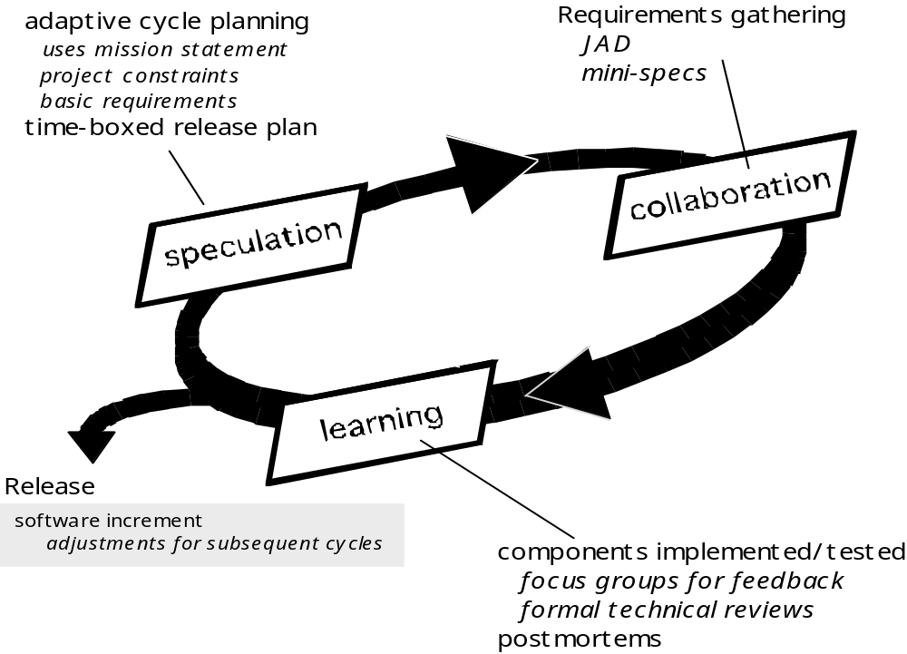
Adaptive Software Development
*JAD = Joint Application Design

Slide 22
Dynamic Systems Development Method
DSDM is
  an agile software development approach
  that provides a framework for building and maintaining systems
  which meet tight time constraints through the use of incremental prototyping
  in a controlled project environment.
Promoted by the DSDM Consortium (www.dsdm.org)

Slide 23
Dynamic Systems Development Method
DSDM—distinguishing features
  Similar in most respects to XP and/or ASD
  Nine guiding principles
    Active user involvement is imperative.
    DSDM teams must be empowered to make decisions.
    The focus is on frequent delivery of products.
    Fitness for business purpose is the essential criterion for acceptance of deliverables.
    Iterative and incremental development is necessary to converge on an accurate business solution.
    All changes during development are reversible.
    Requirements are baselined at a high level
    Testing is integrated throughout the life-cycle.

Slide 24
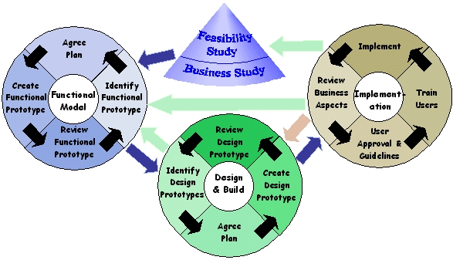
Dynamic Systems Development Method
DSDM Life Cycle

Slide 25
Scrum
A software development method Originally proposed by Schwaber and Beedle in early 1990.
(It is an activity which occurs during a rugby match)
Scrum—distinguishing features
  Development work is partitioned into “packets”
  Testing and documentation are on-going as the product is constructed
  Work units occurs in “sprints” and is derived from a “backlog” of existing changing prioritized requirements
  Changes are not introduced in sprints (short term but stable) but in backlog.
  Meetings are very short (15 minutes daily) and sometimes conducted without chairs ( what did you do since last meeting? What obstacles are you encountering? What do you plan to accomplish by next meeting?)
  “demos” are delivered to the customer with the time-box allocated. May not contain all functionalities. So customers can evaluate and give feedbacks.

Slide 26
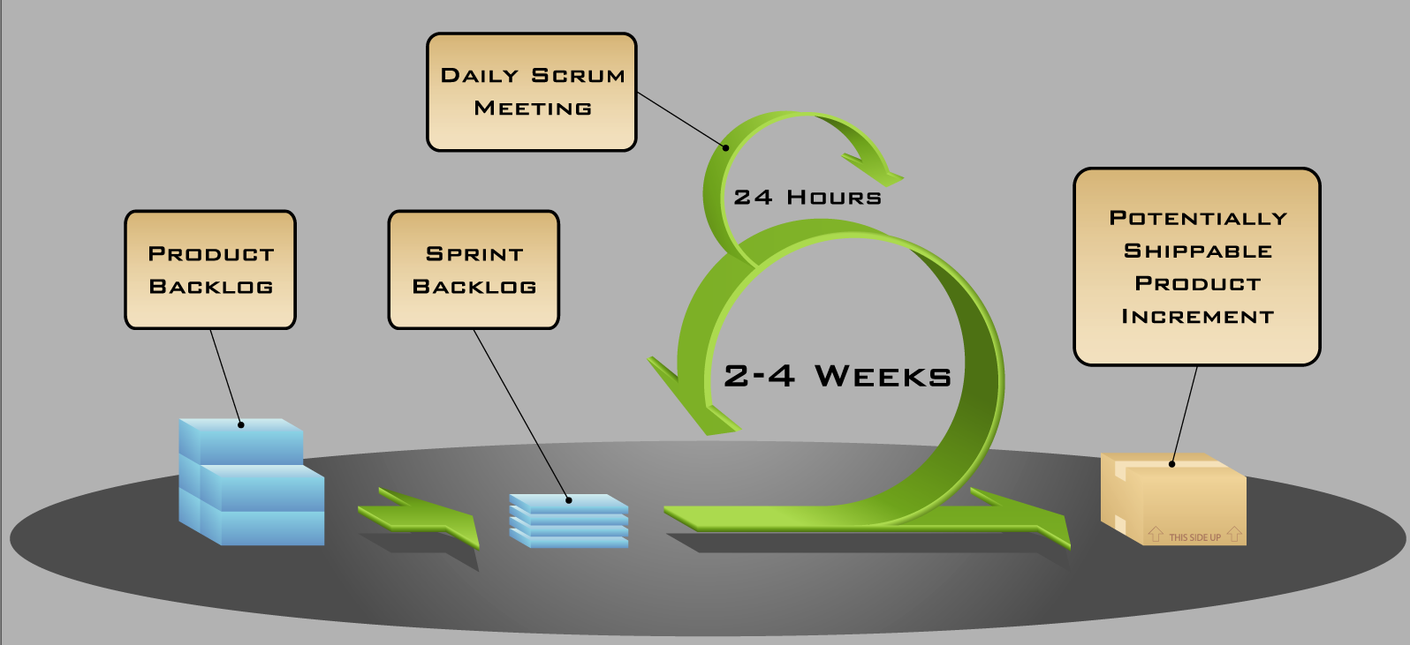
Scrum

Slide 27
Crystal
Alistair Cockburn: "Crystal Clear: A Human-Powered Methodology for Small Teams", Addison-Wesley 2004
Crystal—distinguishing features
  Actually a family of process models that allow “maneuverability” based on problem characteristics
  Face-to-face communication is emphasized
  Suggests the use of “reflection workshops” to review the work habits of the team
*Maneuverable = Capable of changing position
(Wordweb Dictionary)

Slide 28
Crystal
Crystal Light is meant to be a family of methods for different project sizes and criticalities
  Clear, Yellow, Orange, Red, Blue, "and so on“
Only Crystal Clear has been spelled out
Other books may or may not be forthcoming

Slide 29
Crystal
Brief description of Crystal Clear:
  "The lead designer and two to seven other developers
  ... in a large room or adjacent rooms,
  ... using information radiators such as whiteboards or flip charts,
  ... having easy access to expert users,
  ... distractions kept away,
  ... deliver running, tested, usable code to the users
  ... every month or two (quarterly at worst),
  ... reflecting and adjusting their working conventions periodically"

Slide 30
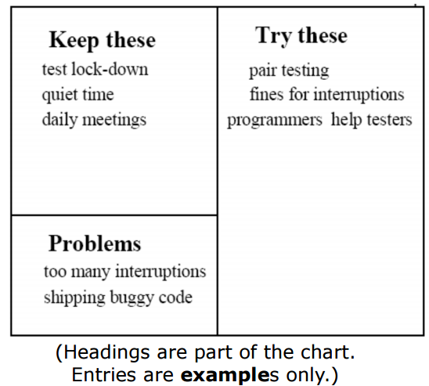
Crystal: Reflection workshop
process improvement technique
Hang a flipchart
  Fill in the chart
    30 minutes

Slide 31
Feature Driven Development
Originally proposed by Peter Coad et al as a object-oriented software engineering process model.
FDD—distinguishing features
  Emphasis is on defining “features” which can be organized hierarchically.
    a feature “is a client-valued function that can be implemented in two weeks or less.”
  Uses a feature template
    <action> the <result> <by | for | of | to> a(n) <object>
    E.g. Add the product to shopping cart.
    Display the technical-specifications of the product.
    Store the shipping-information for the customer.
  A features list is created and “plan by feature” is conducted
  Design and construction merge in FDD

Slide 32
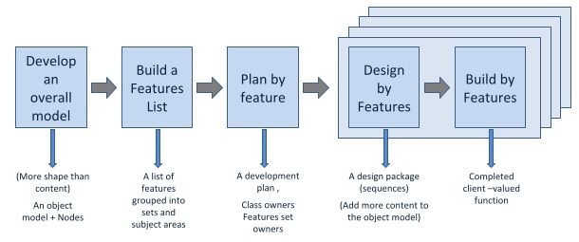
Feature Driven Development

Slide 33
Agile Modeling
Originally proposed by Scott Ambler
Suggests a set of agile modeling principles
  Model with a purpose
  Use multiple models
  Travel light
  Content is more important than representation
  Know the models and the tools you use to create them
  Adapt locally

Slide 34
Summary
Techniques discussed
  Extreme Programming (XP)
  Adaptive Software Development (ASD)
  Dynamic Systems Development Method
  Scrum
  Crystal
  Feature Driven Development
  Agile Modeling

Slide 35
END : AGILE DEVELOPMENTS

